Slide 1
Electronic Commerce Tenth Edition
Chapter 1 Introduction to Electronic Commerce
Notes:
1

Slide 2
Learning Objectives
In this chapter, you will learn about:
What electronic commerce is and how it has evolved into a second wave of growth
Why companies concentrate on revenue models and the analysis of business processes instead of business models when they undertake electronic commerce initiatives
How economic forces have created a business environment that is fostering the continued growth of electronic commerce
2

Slide 3
Learning Objectives (cont’d.)
3
How businesses use value chains and SWOT analysis to identify electronic commerce opportunities
The international nature of electronic commerce and the challenges that arise in engaging in electronic commerce on a global scale
Notes:
3

Slide 4
Electronic Commerce: Into the Third Wave
Electronic commerce history
Mid-1990s to 2000: rapid growth
“Dot-com boom” followed by “dot-com bust”
2000 to 2003: overly gloomy news reports
2003: signs of new life
Sales and profit growth return
Electronic commerce growing at a rapid pace
Electronic commerce becomes part of general economy
4

Slide 5
Electronic Commerce: Into the Third Wave (cont’d)
2008 general recession
Electronic commerce hurt less than most of economy
Second wave continued forward
Handheld devices lend the opportunity for third wave
5

Slide 6
Electronic Commerce and Electronic Business
6
Electronic commerce
Shopping on the Web
Businesses trading with other businesses
Internal company processes
Broader term: electronic business (e-business)
Electronic commerce includes:
All business activities using Internet technologies
Internet and World Wide Web (Web)
Wireless transmissions on mobile telephone networks
Dot-com (pure dot-com)
Businesses operating only online

Slide 7
Categories of Electronic Commerce
7
Dot-com (pure dot-com)
Businesses operating only online
Business-to-consumer (B2C)
Consumer shopping on the Web
Business-to-business (B2B): e-procurement
Transactions conducted between Web businesses
Supply management (procurement) departments
Negotiate purchase transactions with suppliers

Slide 8
Categories of Electronic Commerce (cont’d.)
Activity
Task performed by a worker in the course of doing his or her job
May or may not be related to a transaction
Transaction: exchange of value
Purchase, sale, or conversion of raw materials into finished product
Involves at least one activity

Slide 9
Categories of Electronic Commerce (cont’d.)
Business processes
Group of logical, related, sequential activities and transactions
Web helping people work more effectively
Telecommuting (telework)

Slide 10
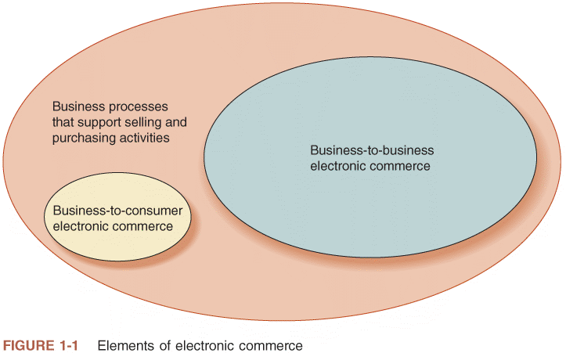
© Cengage Learning 2013
FIGURE 1-1 Elements of electronic commerce

Slide 11
Categories of Electronic Commerce (cont’d.)
Elements of electronic commerce
Relative sizes of elements
Rough approximation
Dollar volume and number of transactions
B2B much greater than B2C
Number of transactions
Supporting business processes greater than B2C and B2B combined

Slide 12
Categories of Electronic Commerce (cont’d.)
Consumer-to-consumer (C2C)
Individuals buying and selling among themselves
Web auction site
C2C sales included in B2C category
Seller acts as a business (for transaction purposes)
Business-to-government (B2G)
Business transactions with government agencies
Paying taxes, filing required reports
B2G transactions included in B2B discussions
12

Slide 13
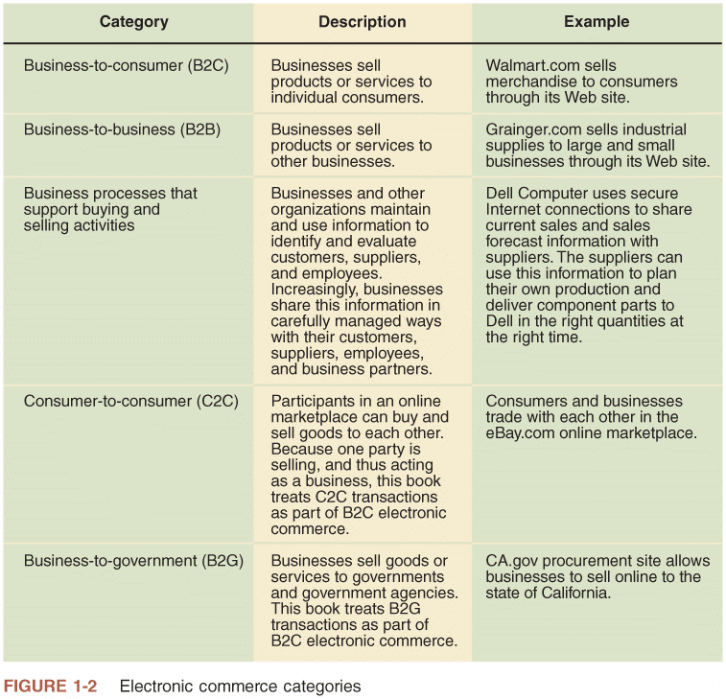
FIGURE 1-2 Electronic commerce categories

Slide 14
The Development and Growth of Electronic Commerce
14
People engaging in commerce:
Adopt available tools and technologies
Internet
Changed way people buy, sell, hire, and organize business activities
More rapidly than any other technology
Electronic Funds Transfers (EFTs)
Wire transfers
Electronic transmissions of account exchange information
Uses private communications networks

Slide 15
The Development and Growth of Electronic Commerce (cont’d.)
15
Electronic Data Interchange (EDI)
Business-to-business transmission of computer-readable data in standard format
Standard transmitting formats benefits
Reduces errors
Avoids printing and mailing costs
Eliminates need to reenter data
Trading partners
Businesses engaging in EDI with each other
EDI pioneers (General Electric, Sears, Walmart)
Improved purchasing processes and supplier relationships

Slide 16
The Development and Growth of Electronic Commerce (cont’d.)
16
Problem faced by EDI pioneers
High implementation cost
Expensive computer hardware and software
Establishing direct network connections to trading partners or subscribing to value-added network (VAN)
Value-added network (VAN)
Independent firm offering EDI connection and transaction-forwarding services
Ensure transmitted data security
Charge fixed monthly fee plus per transaction charge
Gradually moved EDI traffic to the Internet
Reduced EDI costs

Slide 17
The Dot-Com Boom, Bust, and Rebirth
1997 to 2000 irrational exuberance
12,000 Internet-related businesses started
$100 billion of investors’ money
5,000+ companies went out of business or acquired
2000 to 2003
$200 billion invested
Fueled online business activity growth rebirth
Online B2C sales growth continued more slowly
2008-2009 recession
B2C and B2B increasing growth rates continue
Driving force: people with Internet access increasing
Web purchases: projected $11.9 trillion by 2013
17

Slide 18
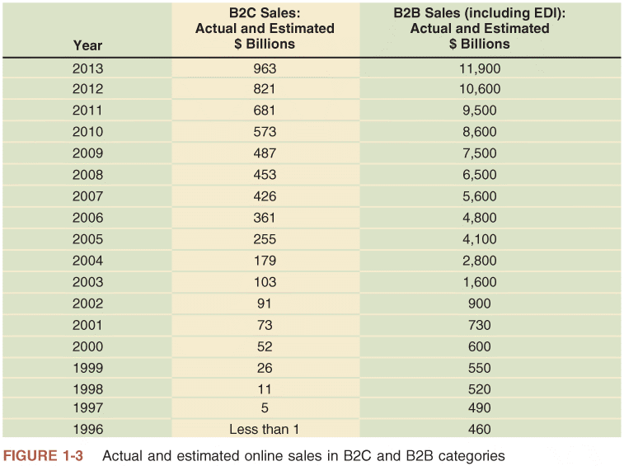
FIGURE 1-3 Actual and estimated online sales in B2C and B2B categories

Slide 19
The Second Wave of Electronic Commerce
19
Compared to four waves of Industrial Revolution
Electronic commerce first and second wave characteristics
Regional scope
First wave: United States phenomenon
Second wave: international
Start-up capital
First wave: easy to obtain
Second wave: companies using internal funds
Internet technologies used
First wave: slow and inexpensive (especially B2C)
Second wave: broadband connections

Slide 20
The Second Wave of Electronic Commerce (cont’d.)
20
First and second wave characteristics (cont’d.)
Electronic mail (e-mail) use
First wave: unstructured communication
Second wave: integral part of marketing, customer contact strategies
Revenue source
First wave: online advertising (failed)
Second wave: Internet advertising (more successful)

Slide 21
The Second Wave of Electronic Commerce (cont’d.)
21
First and second wave characteristics (cont’d.)
Digital product sales
First wave: fraught with difficulties (music industry)
Second wave: fulfilling available technology promise
Business online strategy
First wave: first-mover advantage
Second wave: businesses not relying on first-mover advantage

Slide 22
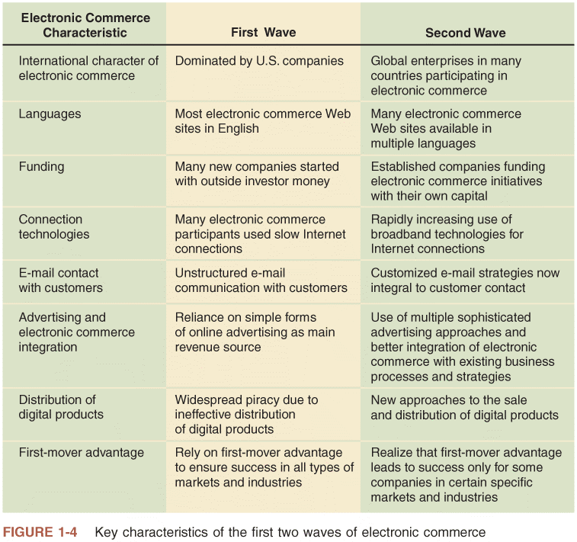
FIGURE 1-4 Key characteristics of the first two waves of electronic commerce

Slide 23
The Third Wave Begins
Accentuated by mobile telephone based commerce (mobile commerce or m-commerce)
Smart phone technology and tablet computers have made Internet available everywhere
Internet technology integration
First wave: bar codes, scanners
Second wave: Radio Frequency Identification (RFID) devices, smart cards, biometric technologies
Increasing integration will lead to more effective B2B
Web 2.0: making new Web business possible

Slide 24
Business Models, Revenue Models, and Business Processes
24
Business model
Set of processes combined to achieve company goal of yielding profit
Electronic commerce first wave
Investors sought Internet-driven business models
Expectations of rapid sales growth, market dominance
Successful “dot-com” business models were emulated
Michael Porter argued business models did not exist

Slide 25
Business Models, Revenue Models, and Business Processes (cont’d.)
25
Instead of copying model, examine business elements
Streamline, enhance, and replace with Internet technology driven processes
Revenue model used today
Specific collection of business processes
Identify customers
Market to those customers
Generate sales
Classify revenue-generating activities for communication and analysis purposes

Slide 26
Focus on Specific Business Processes
26
Companies think in terms of business processes
Purchasing raw materials or goods for resale
Converting materials and labor into finished goods
Managing transportation and logistics
Hiring and training employees
Managing business finances
Identify processes benefiting from e-commerce technology
Internet technologies as a means to facilitate business processes
Improve existing practices, identify new opportunities, adapt to change

Slide 27
Role of Merchandising
27
Merchandising
Combination of store design, layout, and product display knowledge
Salespeople skills
Identify customer needs
Find products or services meeting needs
Merchandising and personal selling
Difficult to practice remotely
Web site success
Transfer merchandising skills to the Web
Easier for some products than others

Slide 28
Product/Process Suitability to Electronic Commerce
Evaluating advantages/disadvantages of electronic commerce
Suitability is dependent on available technologies’ current state
Change as new e-commerce tools emerge

Slide 29
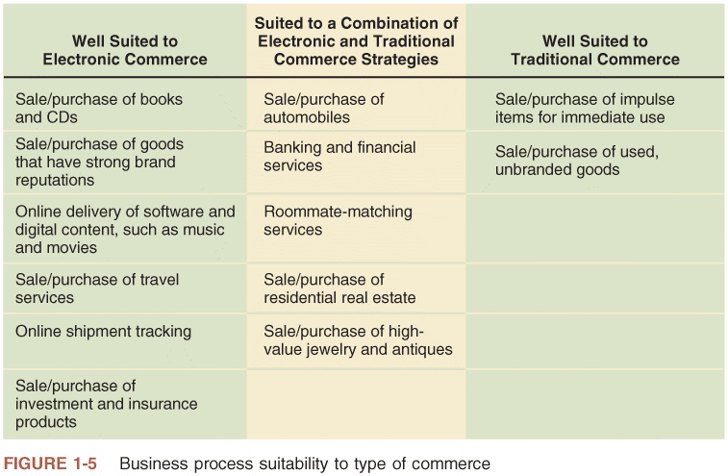
FIGURE 1-5 Business process suitability to type of commerce

Slide 30
Product/Process Suitability to Electronic Commerce (cont’d.)
30
Commodity item: well-suited to e-commerce selling
Product or service hard to distinguish from same products or services provided by other sellers
Features: standardized and well known
Price: distinguishing factor
Consider product’s shipping profile
Collection of attributes affecting how easily that product can be packaged and delivered
Note value-to-weight ratio
DVD: good example
Expensive jewelry: high value-to-weight ratio

Slide 31
Product/Process Suitability to Electronic Commerce (cont’d.)
31
Easier-to-sell products have:
Strong brand reputation
Appeal to small but geographically diverse groups
Traditional commerce
Better for products relying on personal selling skills
Combination of electronic and traditional commerce
Business process includes both commodity and personal inspection items

Slide 32
Electronic Commerce: Opportunities, Cautions and Concerns
32
Businesses need to exercise caution in weighing risks and benefits of online business

Slide 33
Opportunities for Electronic Commerce
Appeal of electronic commerce is its potential to boost profits
increases sales
decreases costs
Virtual community: gathering of people online
Using Web 2.0 technologies

Slide 34
Opportunities for Electronic Commerce (cont’d.)
E-commerce buyer opportunities
Increases purchasing opportunities
Identifies new suppliers and business partners
Efficiently obtains competitive bid information
Easier to negotiate price and delivery terms
Increases speed, information exchange accuracy
Wider range of choices available 24 hours a day
Immediate access to prospective purchase information

Slide 35
Advantages and Disadvantages of Electronic Commerce (cont’d.)
35
Benefits extend to general society welfare
Lower costs to issue and secure:
Electronic payments of tax refunds
Public retirement
Welfare support
Provides faster transmission
Provides fraud, theft loss protection
Electronic payments easier to audit and monitor
Reduces commuter-caused traffic, pollution
Due to telecommuting
Products and services available in remote areas

Slide 36
Electronic Commerce: Cautions and Concerns
36
Poor choices for electronic commerce
Perishable foods and high-cost, unique items
Disadvantages will disappear when:
E-commerce matures
Becomes more available to and accepted by general population
Critical masses of buyers become equipped, willing to buy through Internet
Online grocery industry example

Slide 37
Electronic Commerce: Cautions and Concerns (cont’d.)
37
Predictability of Costs and Revenues: inherent problems
Calculating return on investment
Recruiting and retaining employees
Technology Integration Issues
Difficulty melding standard processes with online systems
Uncertain outcome when integrating systems

Slide 38
Electronic Commerce: Cautions and Concerns (cont’d.)
Cultural and legal concerns
Consumers resistant to change
Cultural differences: security, privacy, and payments
Ambiguous and conflicting laws

Slide 39
Economic Forces and Electronic Commerce
Economics
Study how people allocate scarce resources
Through commerce and government actions
Commerce organizations participate in markets
Potential sellers come into contact with buyers
Medium of exchange available (currency or barter)
Organization hierarchy (flat or many levels)
Bottom level includes largest number of employees
Pyramid structure
Transaction costs
Motivation for moving economic activity to hierarchically structured firms
39

Slide 40
Transaction Costs
40
Total costs a buyer and seller incur
While gathering information and negotiating purchase-and-sale transaction
Includes:
Brokerage fees and sales commissions
Cost of information search and acquisition
Sweater dealer example (Figure 1-6)

Slide 41
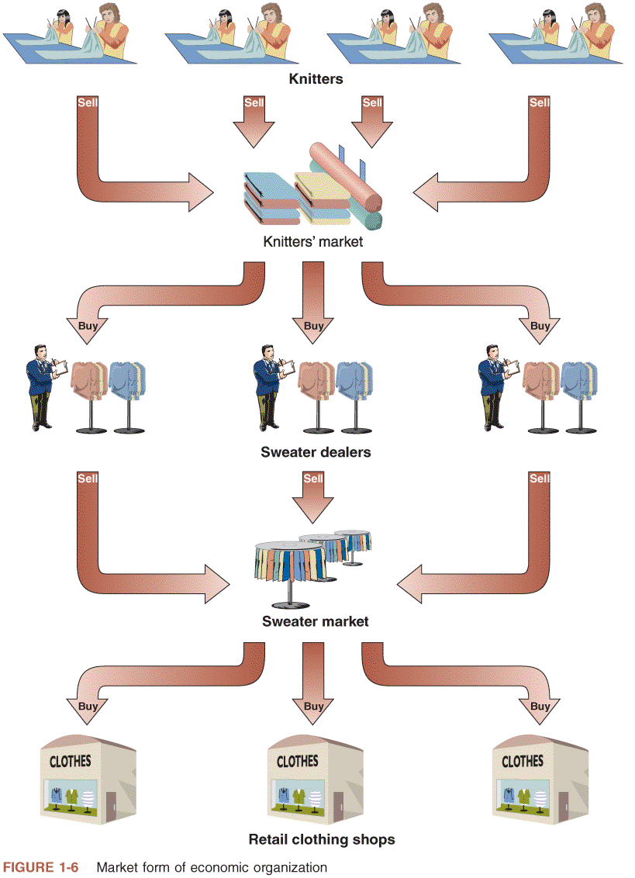
© Cengage Learning 2013
FIGURE 1-6 Market form of economic organization

Slide 42
Markets and Hierarchies
42
Coase’s analysis of high transaction costs
Hierarchical organizations formed
Replace market-negotiated transactions
Strong supervision and worker-monitoring elements
Sweater example (Figure 1-7)
Oliver Williamson (extended Coase’s analysis)
Complex manufacturing, assembly operations
Hierarchically organized, vertically integrated
Manufacturing innovations increased monitoring activities’ efficiency and effectiveness

Slide 43
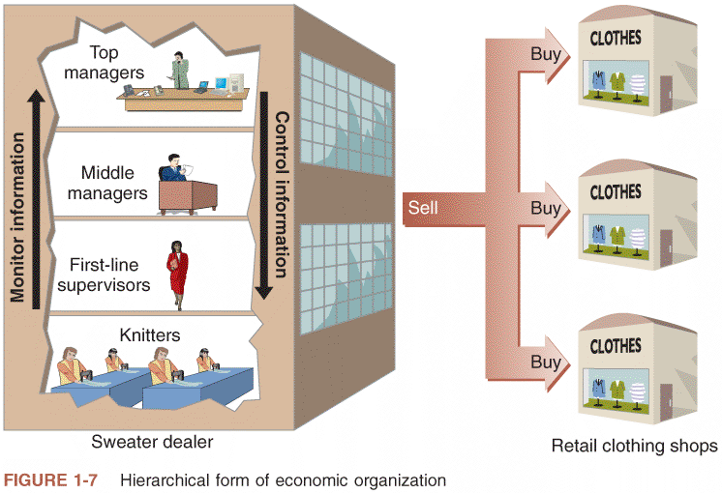
© Cengage Learning 2013
FIGURE 1-7 Hierarchical form of economic organization
Strategic business unit (business unit)
One particular combination of product, distribution channel, and customer type
Exception to hierarchy trend
Commodities

Slide 44
Using Electronic Commerce to Reduce Transaction Costs
44
Electronic commerce
Change vertical integration attractiveness
Change transaction costs’ level and nature
Example: employment transaction
Telecommuting
May reduce or eliminate transaction costs

Slide 45
Network Economic Structures
45
Neither market nor hierarchy
Strategic alliances (strategic partnerships)
Coordinate strategies, resources, skill sets
Form long-term, stable relationships with other companies and individuals
Based on shared purposes
Strategic partners
Come together for specific project or activity
Form many intercompany teams
Undertake variety of ongoing activities

Slide 46
Network Economic Structures (cont’d.)
46
Network organizations
Well suited to information-intensive technology industries
Sweater example
Knitters organize into networks of smaller organizations
Specialize in styles or designs
Electronic commerce makes such networks easier to construct and maintain
Will be predominant in the near future
Manuel Castells predicts economic networks will become the organizing structure for all social interactions

Slide 47
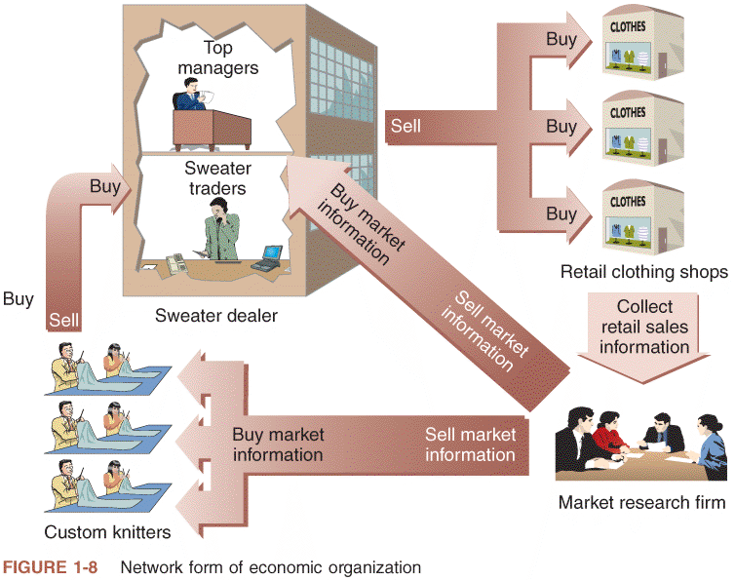
© Cengage Learning 2013
FIGURE 1-8 Network form of economic organization

Slide 48
Network Effects
48
Activities yield less value as consumption amount increases
Law of diminishing returns
Example: hamburger consumption
Network effect
Exception to law of diminishing returns
More people or organizations participate in network
Value of network to each participant increases
Examples: Landline and mobile phones

Slide 49
Network Effects (cont’d.)
49
E-mail account example
Provides access to network of people with e-mail accounts
If e-mail account is part of smaller network
E-mail generally less valuable
Internet e-mail accounts
Far more valuable than single-organization e-mail
Due to network effect
Need way to identify business processes
Evaluate electronic commerce suitability
For each process

Slide 50
Identifying Electronic Commerce Opportunities
50
Focus on specific business processes
Break business down
Series of value-adding activities
Combine to generate profits, meet firm’s goal
Commerce conducted by firms of all sizes
Firm
Multiple business units owned by a common set of shareholders or company
Industry
Multiple firms selling similar products to similar customers

Slide 51
Strategic Business Unit Value Chains
Value chain
Organizing strategic business unit activities to design, produce, promote, market, deliver, and support the products or services
Michael Porter includes supporting activities
Human resource management and purchasing
Strategic business unit primary activities
Identify customers, design, purchase materials and supplies, manufacture product or create service, market and sell, deliver, provide after-sale service and support

Slide 52
Strategic Business Unit Value Chains (cont’d.)
Strategic business unit primary activities (cont’d.)
Importance depends on:
Product or service business unit provides
Customers
Central corporate organization support activities
Finance and administration
Human resource
Technology development

Slide 53
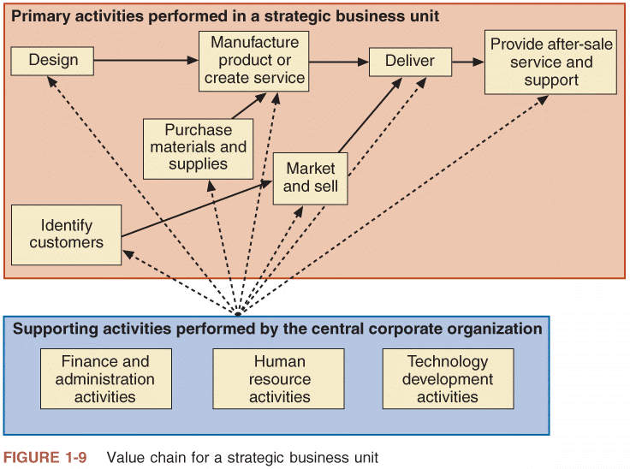
© Cengage Learning 2013
FIGURE 1-9 Value chain for a strategic business unit
Left-to-right flow
Does not imply strict time sequence

Slide 54
Industry Value Chains
Examine where strategic business unit fits within industry
Porter’s value system
Describes larger activities stream into which particular business unit’s value chain is embedded
Industry value chain refers to value systems
Delivery of product to customer
Use as purchased materials in its value chain
Awareness of businesses value chain activities
Allows identification of new opportunities
Useful way to think about general business strategy

Slide 55
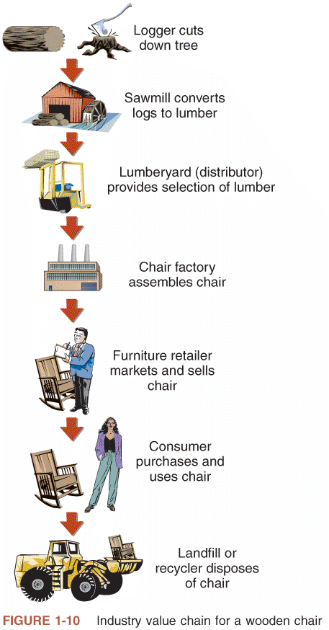
© Cengage Learning 2013
FIGURE 1-10 Industry value chain for a strategic business unit

Slide 56
SWOT Analysis: Evaluating Business Unit Opportunities
SWOT analysis
Strengths, weaknesses, opportunities, and threats
Consider all issues systematically
First: look into business unit
Identify strengths and weaknesses
Then: review operating environment
Identify opportunities and threats presented
Take advantage of opportunities
Build on strengths
Avoid threats
Compensate for weaknesses

Slide 57
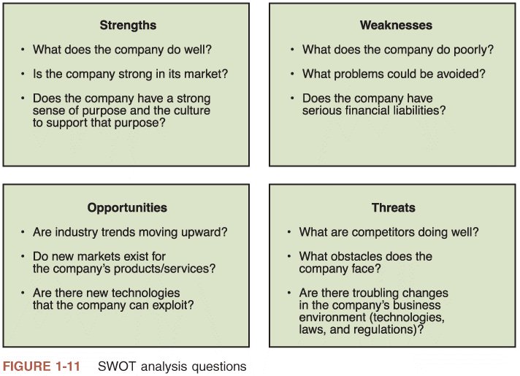
© Cengage Learning 2013
FIGURE 1-11 SWOT analysis questions

Slide 58
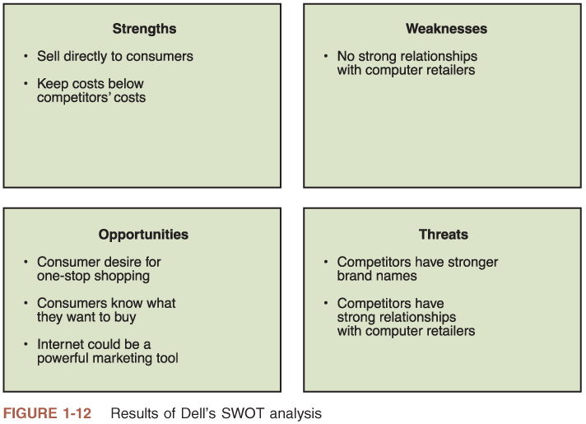
© Cengage Learning 2013
FIGURE 1-12 Results of Dell’s SWOT analysis

Slide 59
International Nature of Electronic Commerce
Internet connects computers worldwide
When companies use Web to improve business process:
They automatically operate in global environment
Electronic commerce is growing in and outside the US (Refer to Figure 1-13)

Slide 60
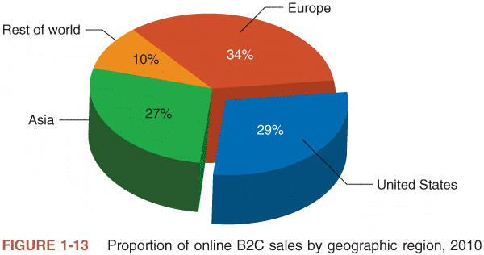
© Cengage Learning 2013
FIGURE 1-13 Proportion of online B2C sales by geographic region, 2010

Slide 61
International Nature of Electronic Commerce (cont’d.)
Key international commerce issues
Trust
Culture
Language
Government
Infrastructure

Slide 62
Trust Issues on the Web
Important to establish trusting relationships with customers
Rely on established brand names
Difficult for online businesses
Anonymity exists in Web presence
Banking example: browsing site’s pages
Difficult to determine bank size or how well established
Business must overcome distrust in Web “strangers”

Slide 63
Language Issues
Business must adapt to local cultures
“Think globally, act locally”
Provide local language versions of Web site
Customers more likely to buy from sites translated into own language
50 percent of Internet content in English
Half of current Internet users do not read English
By 2015: 70% of e-commerce transaction will involve at least one party outside of the United States
Languages may require multiple translations
Separate dialects

Slide 64
Language Issues (cont’d.)
Large site translation may be prohibitive
Decided by corporate department responsible for page content
Mandatory translation into all supported languages
Home page
All first-level links to home page
High priority pages to translate
Marketing, product information, establishing brand
Use translation services and software
Human translation: key marketing messages
Software: routine transaction processing functions

Slide 65
Cultural Issues
Important element of business trust
Anticipating how the other party to a transaction will act in specific circumstances
Culture
Combination of language and customs
Varies across national boundaries, regions within nations
Cultural issue example
Virtual Vineyards (now Wine.com)
Subtle language and cultural standard errors
General Motors’ Chevrolet Nova automobile
Baby food in jars in Africa

Slide 66
Cultural Issues (cont’d.)
Select icons carefully
Shopping cart versus shopping baskets, trolleys
Hand signal for “OK”: obscene gesture in Brazil
Dramatic cultural overtones
India: inappropriate to use cow image in cartoon
Muslim countries: offended by human arms or legs uncovered
White color (purity versus death)
Japan: number four is symbol of death

Slide 67
Cultural Issues (cont’d.)
Online business apprehension
Japanese shoppers’ unwillingness to pay by credit
Softbank
Devised a way to introduce electronic commerce to a reluctant Japanese population

Slide 68
Culture and Government
Online discussion inhospitable to cultural environments
Government controls in some cultures
Unfettered communication not desired
Unfettered communication not considered acceptable
Denounced Internet material content
Unrestricted Internet access forbidden
Filter Web content
Regularly reviews ISPs and their records
Impose language requirements

Slide 69
Culture and Government (cont’d.)
Internet censorship
Restricts electronic commerce
Reduces online participant interest levels
China
Wrestling with issues presented by the growth of the Internet as a vehicle for doing business
Created complex set of registration requirements and regulations governing any business engaging in electronic commerce
Regularly conducts reviews of ISPs and their records
Strong cultural requirements finding their way into the legal codes that govern business conduct

Slide 70
Infrastructure Issues
Internet infrastructure
Computers and software connected to Internet
Communications networks’ message packets travel
Infrastructure variations and inadequacies exist
Outside United States
Government-owned industry
Heavily regulated
High local telephone connection costs
Affect buying online behavior
International orders: global problem
No process to handle order and paperwork

Slide 71
Infrastructure Issues (cont’d.)
Business face challenges posed by variations and inadequacies in the infrastructure supporting the Internet throughout the world
Local connection costs
Inability to handle order
Freight forwarder
Arranges international transactions’ shipping and insurance
Customs broker
Arranges tariff payment and compliance

Slide 72
Infrastructure Issues (cont’d.)
Bonded warehouse
Secure location
Holds international shipments until customs requirements or payments satisfied
Handling international transactions paperwork
Annual cost: $800 billion
Software automates some paperwork
Countries have own paper-based forms, procedures
Countries have incompatible computer systems
See Figure 1-14: complex information flows

Slide 73
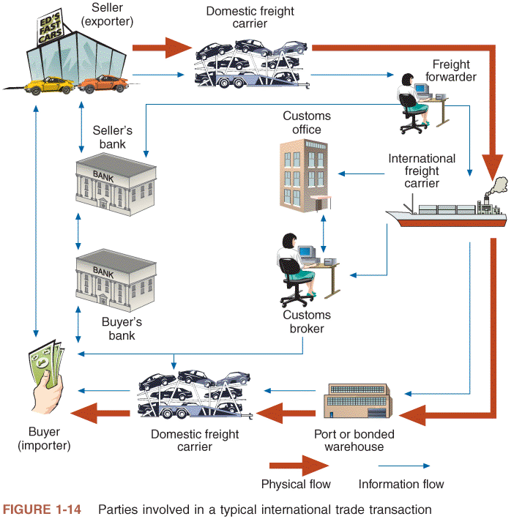
© Cengage Learning 2013
FIGURE 1-14 Parties involved in a typical international trade transaction

Slide 74
Summary
Electronic commerce
Application of new Internet and Web technologies
Helps individuals, businesses, other organizations conduct effective business
Adopted in waves of change
First wave ended in 2000
Second wave focuses on improving specific business processes
Third wave relies on availability of mobile devices with Internet connectivity
74

Slide 75
Summary
Technology improvements
Create new products and services
Improved promotion, marketing, delivery of existing offerings
Improve purchasing and supply activities
Identify new customers
Operate finance, administration, human resource management activities more efficiently
Reduce transaction costs
Create network economic effects
Leads to greater revenue opportunities

Slide 76
Summary (cont’d.)
76
Electronic commerce
Fits into markets, hierarchies, networks
Value chains
Occur at business unit, industry levels
Value chains and SWOT analysis
Tools to understand business processes
Analyze suitability for electronic commerce implementation

Slide 77
Summary (cont’d.)
77
Key international commerce issues
Trust
Culture and language
Government
Infrastructure

